Slide 1
Multiprocessors and multicomputers
UniT 1

Slide 2
Multiprocessor/ parallel systems

Slide 3
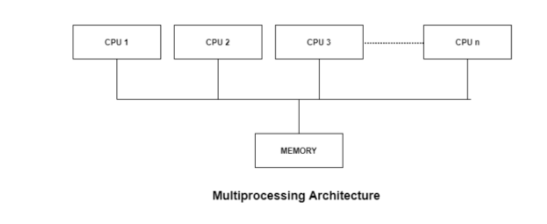

Slide 4
Types of Multiprocessor Systems
Symmetric Multiprocessing (SMP):
All processors are treated equally.
Each CPU runs tasks independently but shares the same memory. Example: Modern desktops, servers.
All the processors are in a peer to peer relationship i.e. no master - slave relationship exists between them.
Asymmetric Multiprocessing (AMP):
One CPU is the master, others are slaves.
Master assigns tasks, slaves execute. Asymmetric multiprocessor system contains a master slave relationship.
each processor is given a predefined task.
There is a master processor that gives instruction to all the other processors. Example: Early supercomputers, embedded systems.

Slide 5
Advantages of Multiprocessor Systems
More reliable Systems - In a multiprocessor system, even if one processor fails, the system will not halt.
Enhanced Throughput- If multiple processors are working together, then the throughput of the system increases i.e. number of processes getting executed per unit of time increases.

Slide 6
More Economic Systems- are cheaper than single processor systems in the long run because they share the data storage, peripheral devices, power supplies etc. If there are multiple processes that share data, it is better to schedule them on multiprocessor systems with shared data than have different computer systems with multiple copies of the data.

Slide 7
Disadvantages of Multiprocessor Systems
Increased Expense - Even though multiprocessor systems are cheaper in the long run than using multiple computer systems, still they are quite expensive. It is much cheaper to buy a simple single processor system than a multiprocessor system.

Slide 8
Complicated Operating System Required - There are multiple processors in a multiprocessor system that share peripherals, memory etc. So, it is much more complicated to schedule processes and impart resources to processes than in single processor systems. Hence, a more complex and complicated operating system is required in multiprocessor systems.

Slide 9
Characteristics of multiprocessor
1. A multiprocessor system is an interconnection of two or more CPUs with shared memory and input-output equipment.
2. The term “processor” in multiprocessor can mean either a central processing unit (CPU) or an input-output processor (IOP).

Slide 10
3. The similarity and distinction between multiprocessor and multicomputer are
• Similarity ▪
Both support concurrent operations
• Distinction
The network (multicomputer system) consists of several autonomous computers that may or may not communicate with each other.
A multiprocessor system is controlled by one operating system that provides interaction between processors.

Slide 11
cz

Slide 12
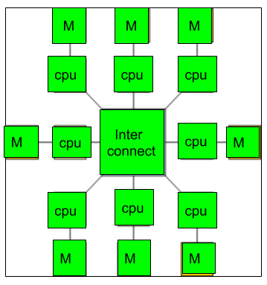

MULTIPROCESSOR
MULTICOMPTER

Slide 13
Multicomputer system
A multicomputer system is a computer system with multiple processors that are connected together to solve a problem.
Each processor has its own memory and it is accessible by that particular processor and those processors can communicate with each other via an interconnection network.

Slide 14
As the multicomputer is capable of messages passing between the processors, it is possible to divide the task between the processors to complete the task. Hence, a multicomputer can be used for distributed computing.

Slide 15
Types of Multicomputers
Cluster Computing
Group of computers connected via LAN.
Grid Computing
Computers connected over a wide area (like the internet).
Cloud Computing
Internet-based distributed computing.

Slide 16
BASIS FOR COMPARISON | MULTIPROCESSOR | MULTICOMPUTER
Basic | Multiple processors in a single computer. | Interlinked multiple autonomous computers.
Memory attached to the processing elements | Single shared | Multiple distributed
Communication between processing elements | Mandatory | Not necessary
Type of network | Dynamic network | Static Nw

Slide 17
END

